Slide 1
Recommending Products to clients
FINTECH 2025-2026 Business Case 2

Slide 2
Data Preprocessing
What can we realistically expect to get out of our dataset?

Slide 3
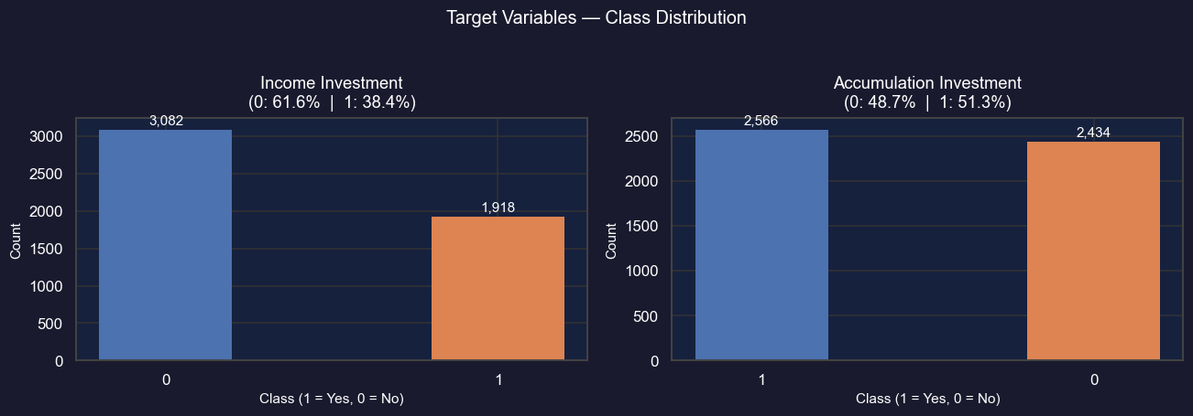
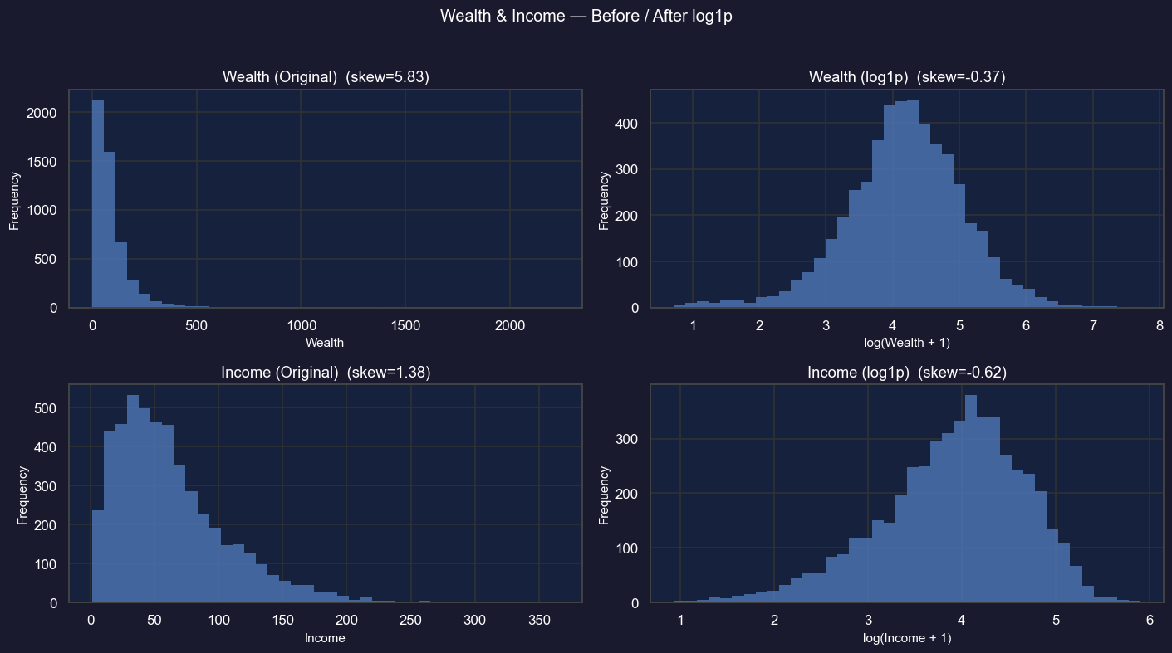
Data Exploration
Our process
Data Cleaning
Drop ID as it is uninformative
Shuffle rows
Separate features from targets
Check target classes balance
Skew reduction
Wealth and Income are highly skewed
We apply log1p for skew reduction

Slide 4
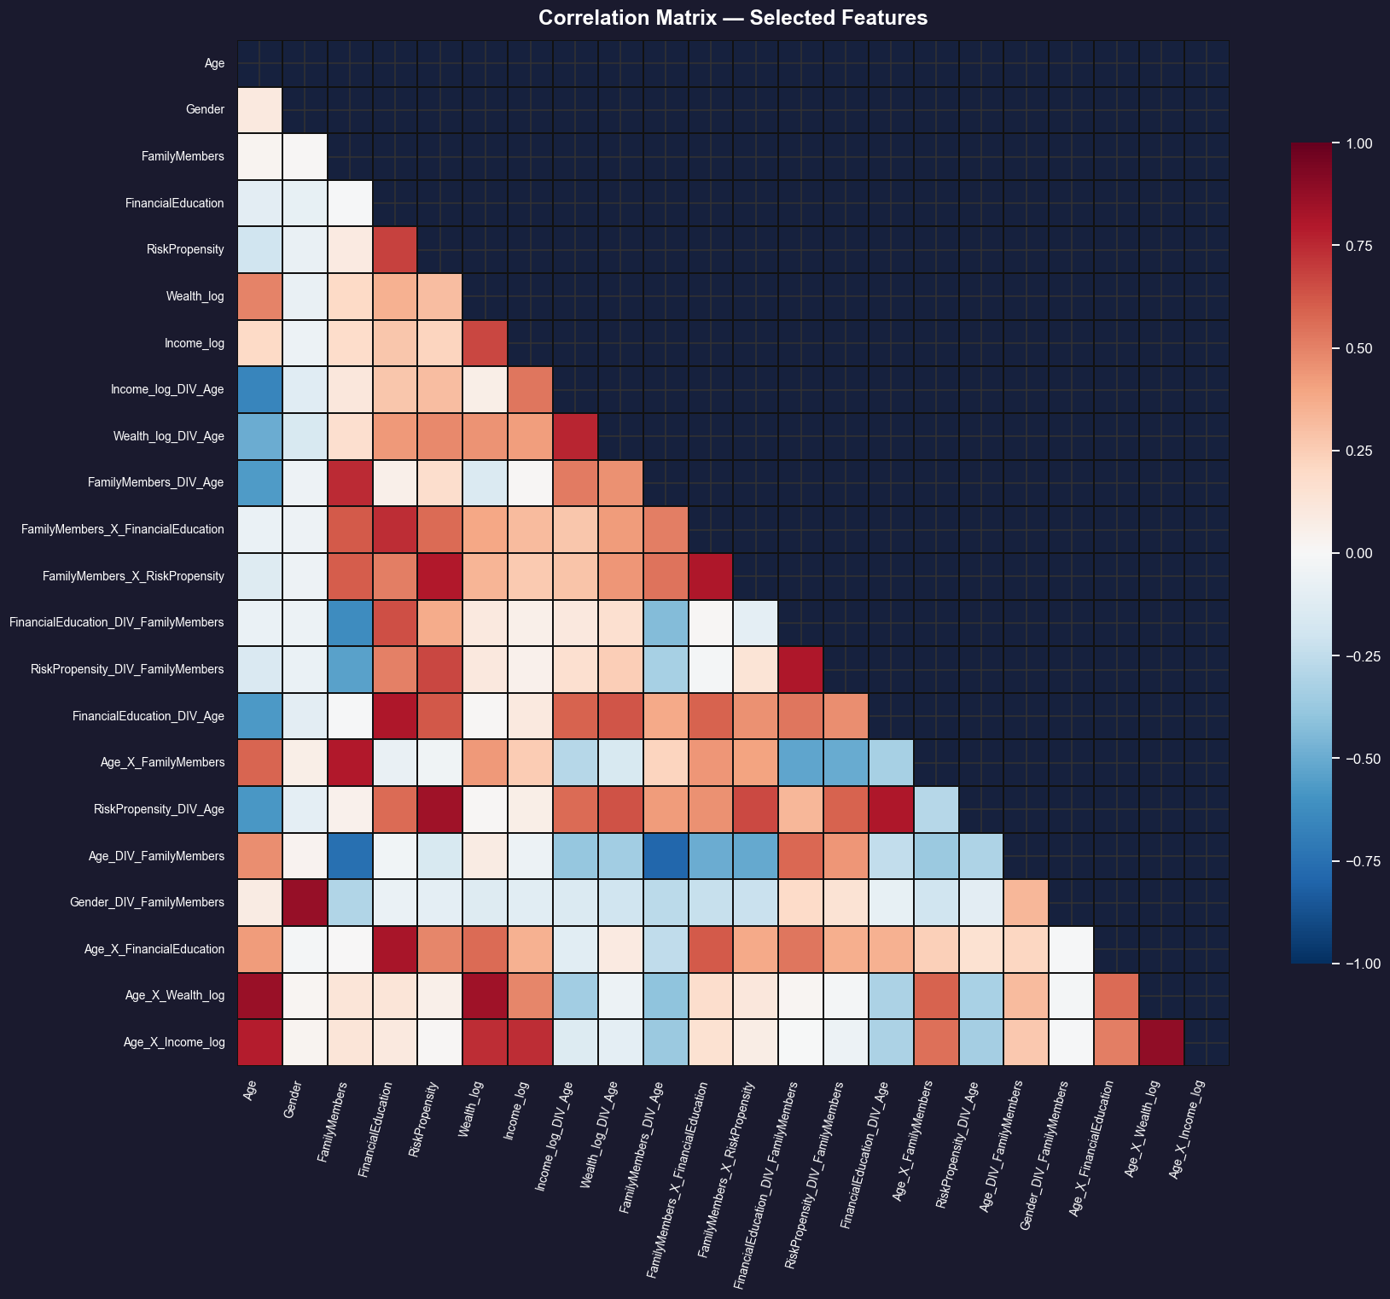
Feature Engineering and Exploratory Data Analysis (aka the result)
The Mathematical Approach
We aim to have low correlation with all variables
And high predictive power
We tried all the combination of 2-3 features with all the operations (+,-,x,/)
The Business Approach
Based on common sense we have:
IncomePerFamilyMember_log = log1p(Income / FamilyMembers)
Income_Wealth_Ratio_log = log1p(Income / Wealth)
SophisticationScore = FinancialEducation × RiskPropensity

Slide 5
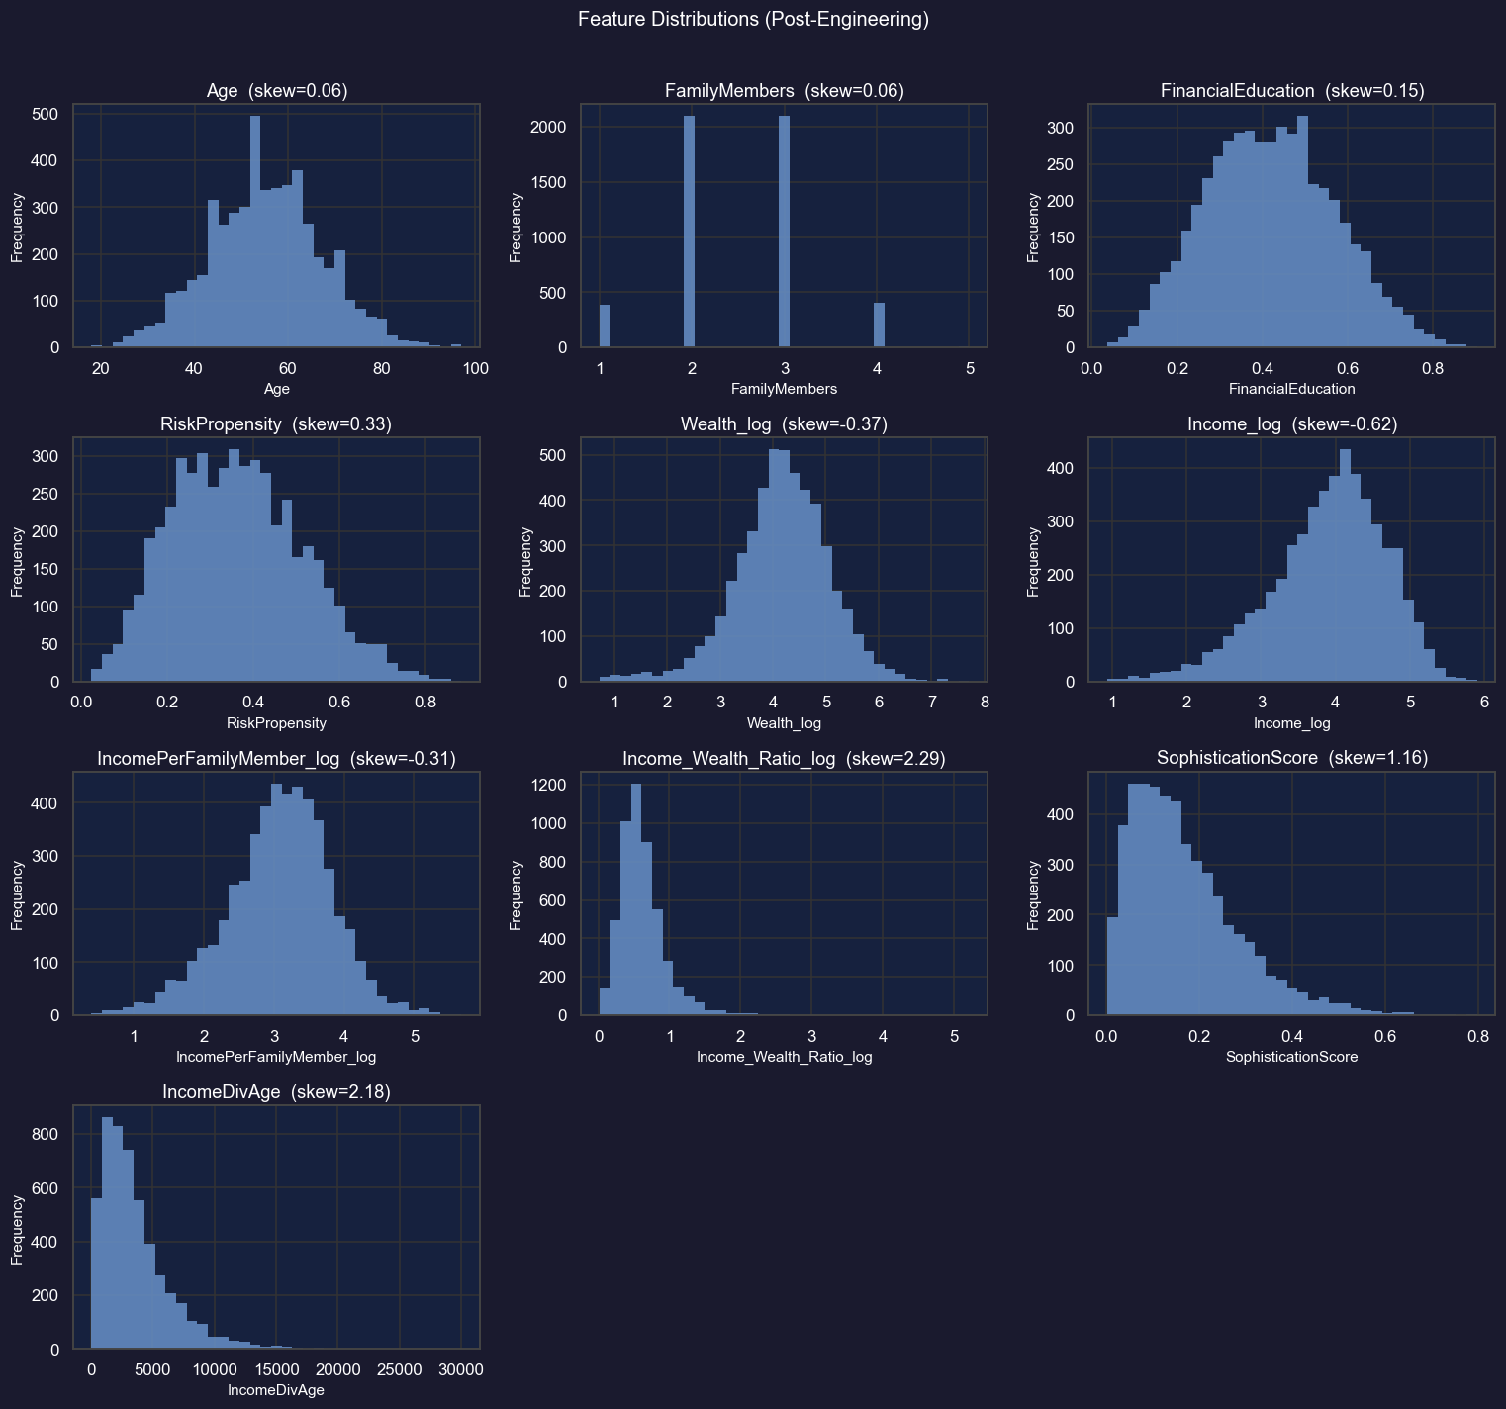
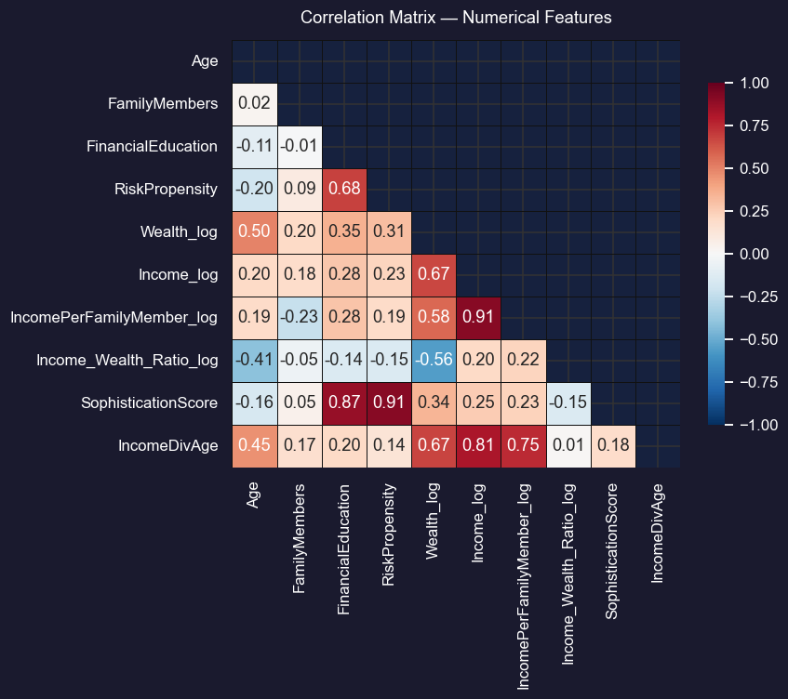
Exploratory Data Analysis: Feature distributions and pairwise correlations after engineering.

Slide 6
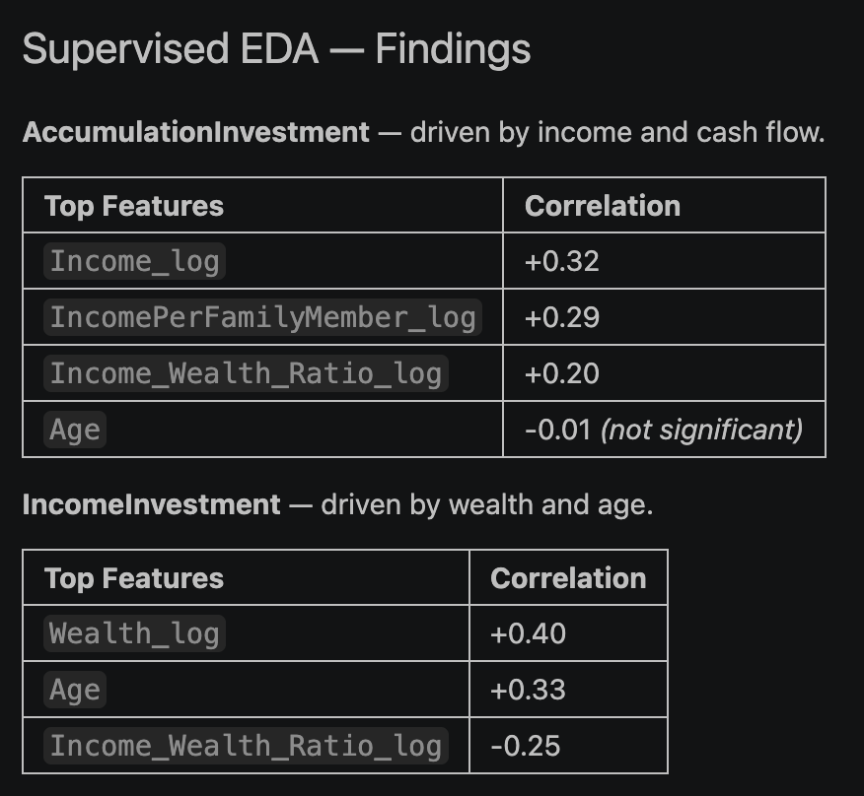
Supervised EDA
We are trying to understand how the features relate to the targets

Slide 7
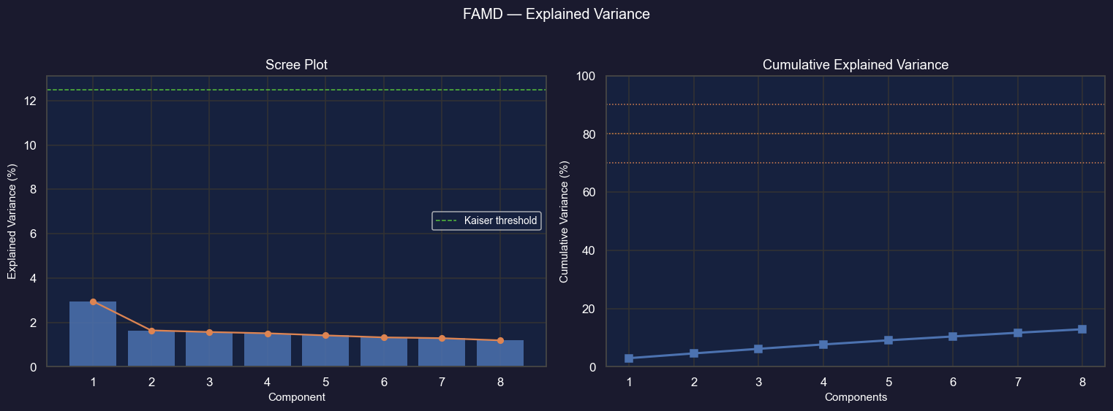
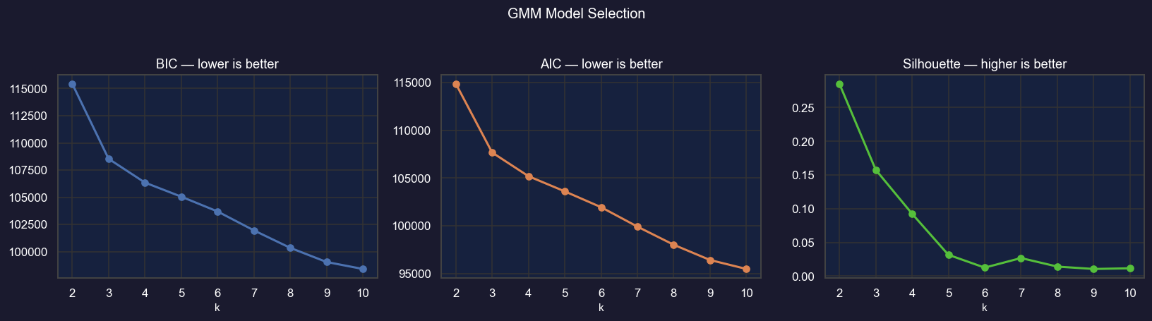
FAMD and GMM
Our findings from both methods aren’t significant.
This means that the variables are highly uncorrelated

Slide 8
The Reccomendation Engine
Classify users with respect to the accumulation or investment plans

Slide 9
Data setup
Apply a stratified 80/20 split of the data to prevent any leakage
Scale the data (so that we have mean 0 and standard deviation 1)

Slide 10
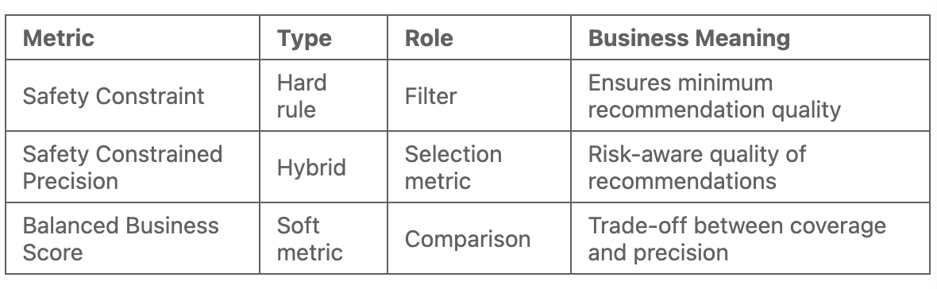
Model Evaluation Strategy (Metrics)
Safety constraint
Optimization Objective
Balanced Business Score
Safety constraint precision
F1 Score

Slide 11
Modelling
Logistic Regression
Linear baseline. Interpretable calibration reference for the ensemble.
XGBoost
Gradient-boosted trees. Strongest nonlinear learner; primary ensemble contributor.
K-Nearest Neighbors
Distance-based; captures local structure missed by global models. Sensitive to dimensionality.
Support Vector Machine
Margin-based classifier. Effective in medium-dimensional spaces; sensitive to scaling.
Gaussian Naive Bayes
Probabilistic baseline assuming feature independence. Fast and stable but limited on complex interactions.

Slide 12
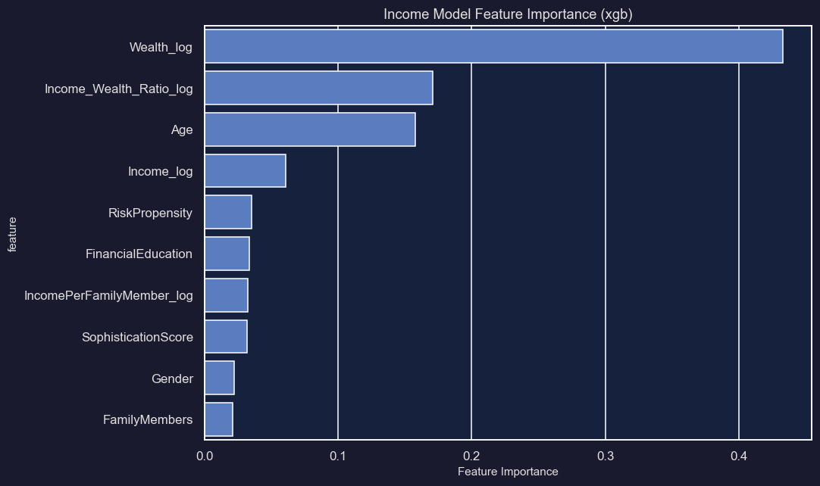
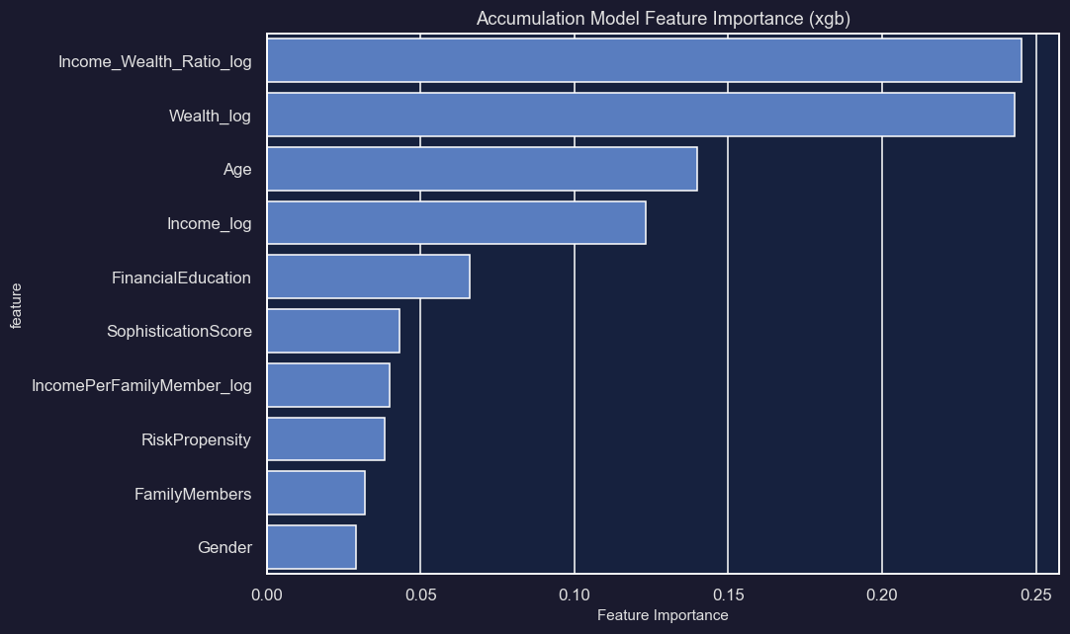
Entropy Diagnostics and Active Learning

Slide 13
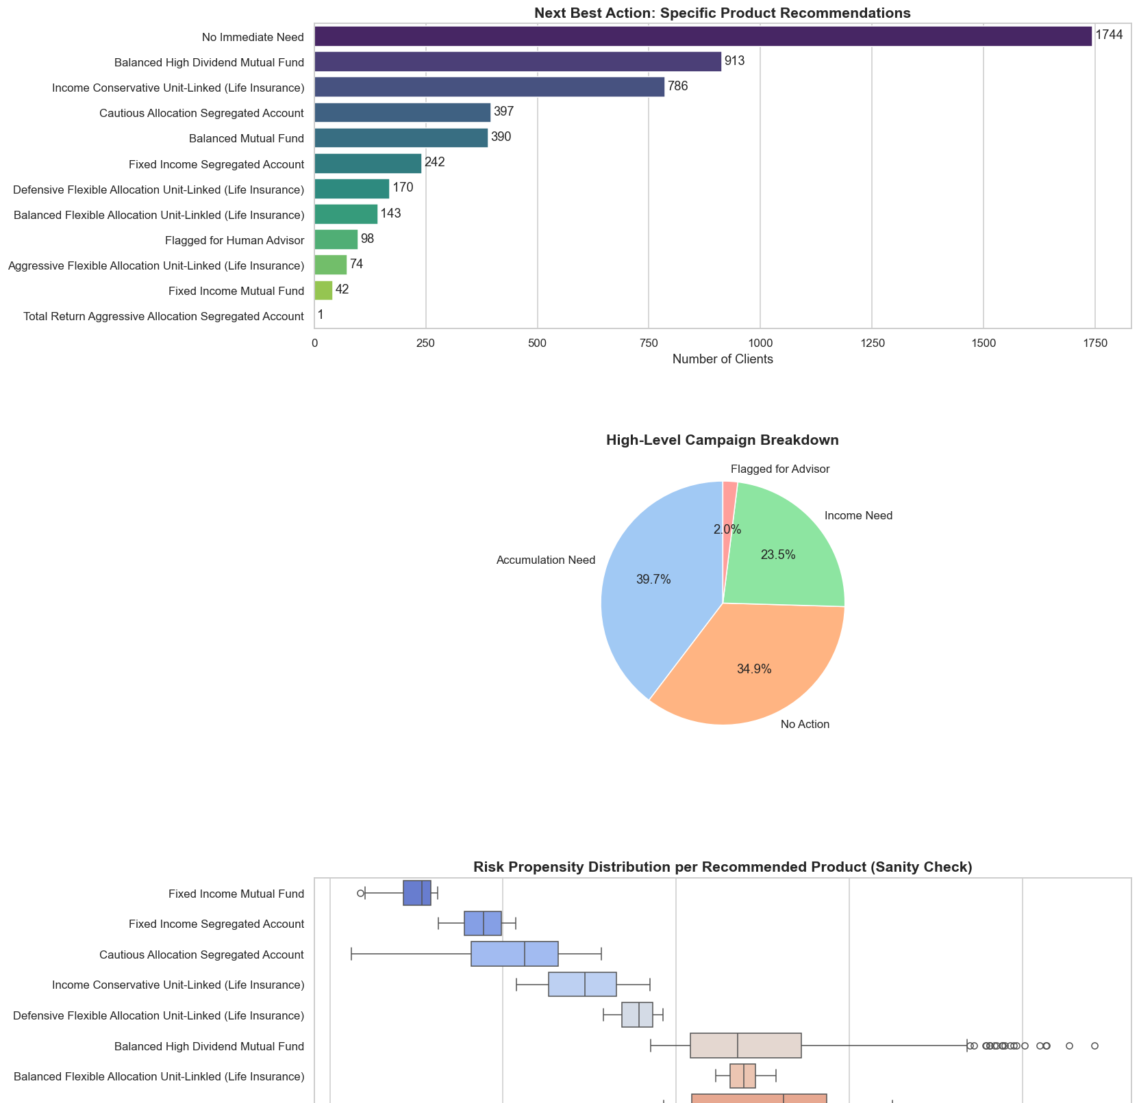
The recommendation system

